Slide 1
Senior Scientist Interview
Deepak Poduval, ARS, Yale University
27 August 2025

Slide 2
Bioinformatics Journey
B.Sc. & M.Sc. in Biotechnology/Bioinformatics – Amrita University
PhD – Translational Cancer Genomics, University of Bergen
Postdoc – University of North Dakota
Associate Scientist – Yale University

Slide 3

August 4, 2025
Transcriptomic and Epigenetic Analysis of D1R+ and D2R+ MSNs in Macaque

Slide 4
Objective
Identify differences in expression of D1R+ and D2R+ striatal neuron subpopulations across Macaque, Human, Mouse, and Rat.
Integrate epigenetic data to characterize regulatory mechanisms.
Identify shared cis-regulatory elements.
Differentiate biological processes or pathways in D1R+ and D2R+
cells.

Slide 5
Understanding Dopamine Receptor Subtypes in the Primate Striatum
Dataset: Single-nuclei RNA-sequencing (snRNA-seq) from GSE167920, containing 63,884
total cells.
Focused on Medium Spiny Neurons (MSNs): D1R+ (direct pathway) vs D2R+ (indirect pathway) Two complementary analyses:
MSNs vs Other cell types - Understanding MSN identity
D1R+ vs D2R+ - Discovering subtype differences

Slide 6
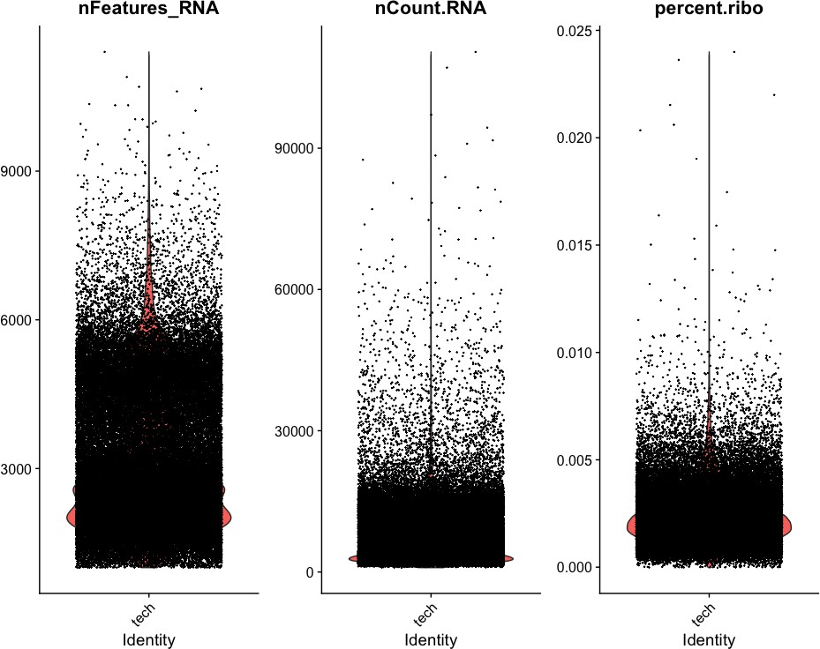
Quality Metrics Across Cell Types

Slide 7
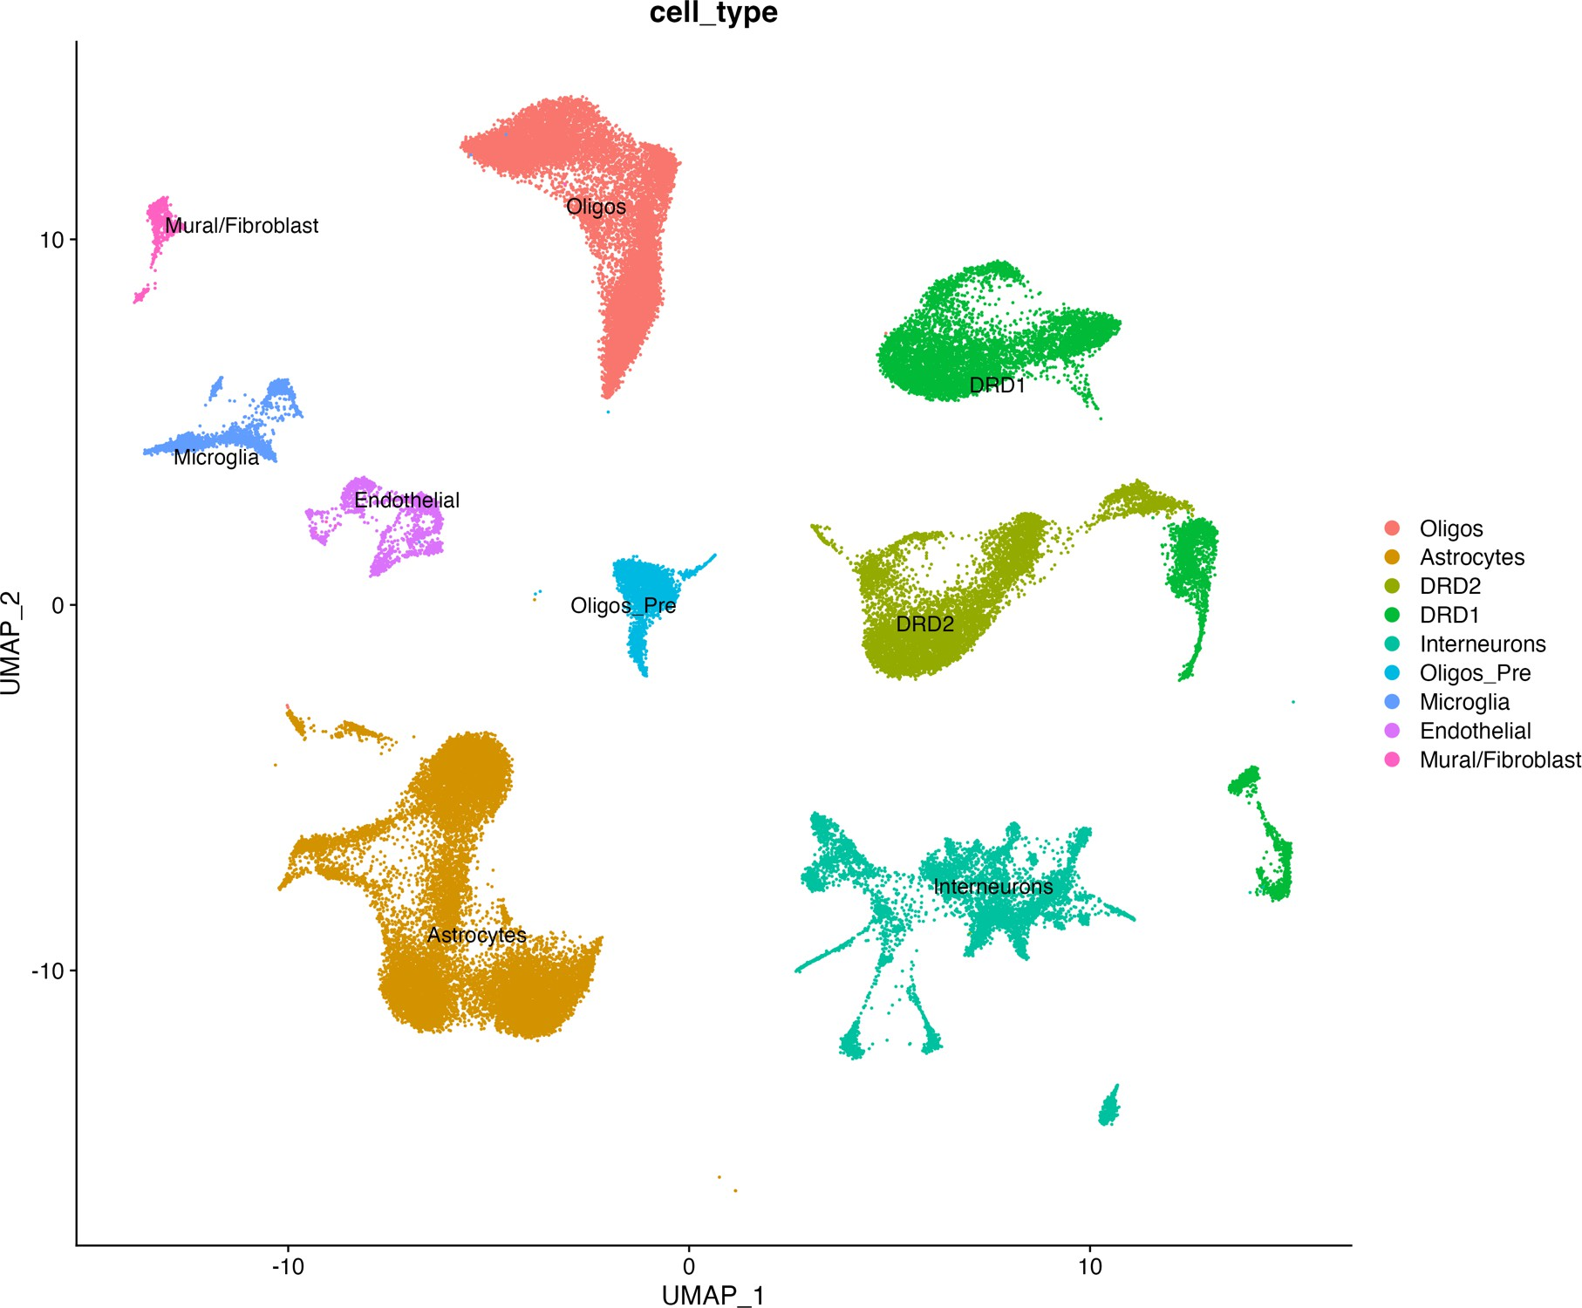
UMAP has clear clusters - reproduced

Slide 8
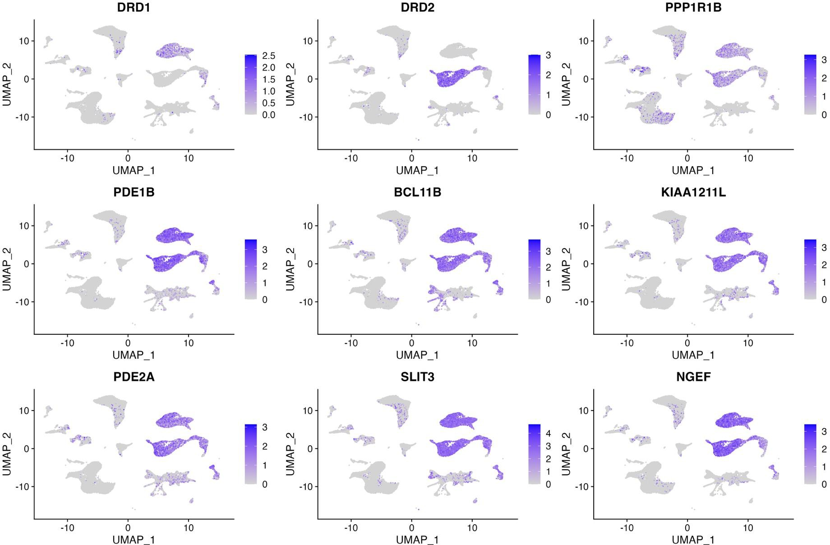
Biomarkers for D1R and D2R from the study

Slide 9
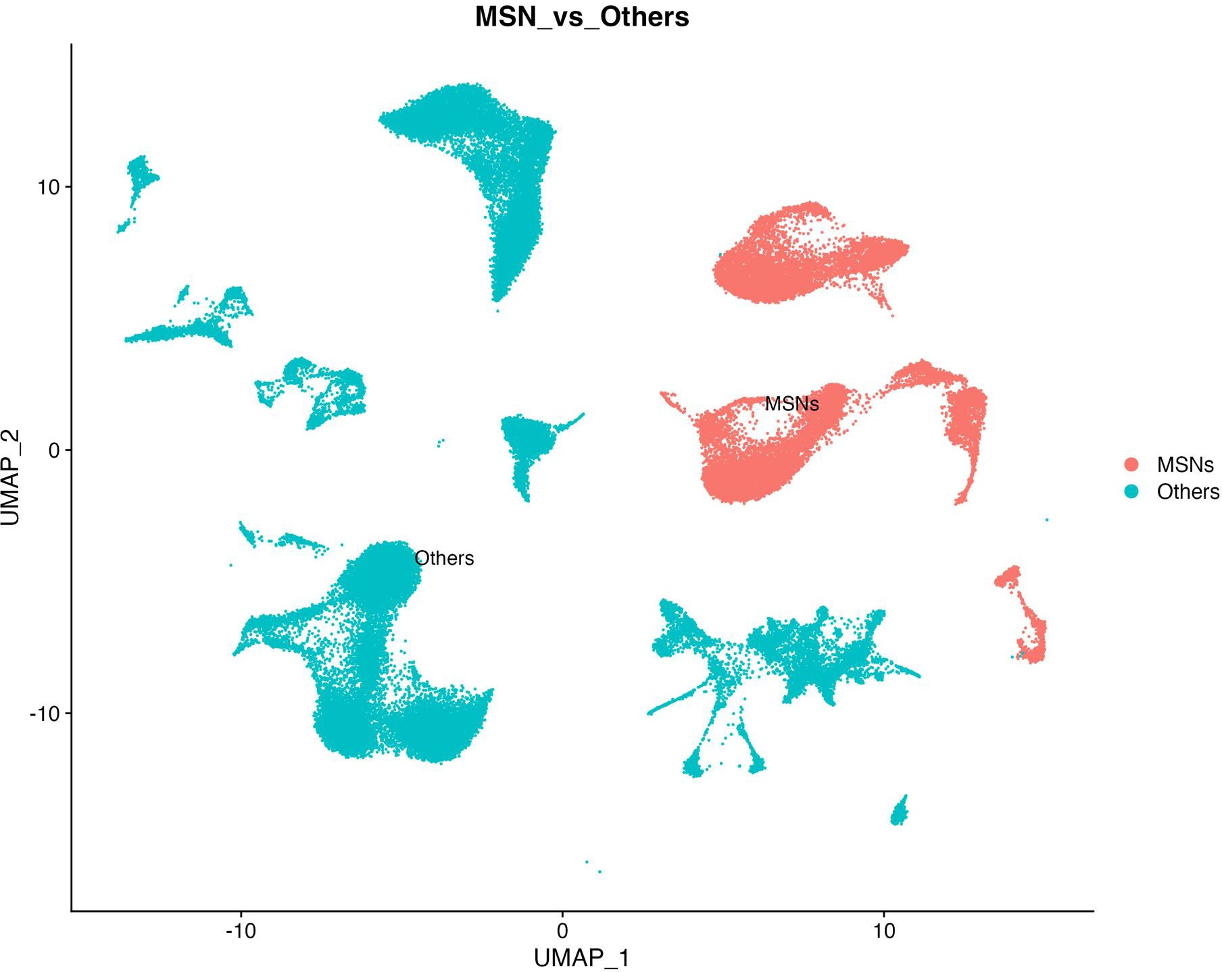

Slide 10
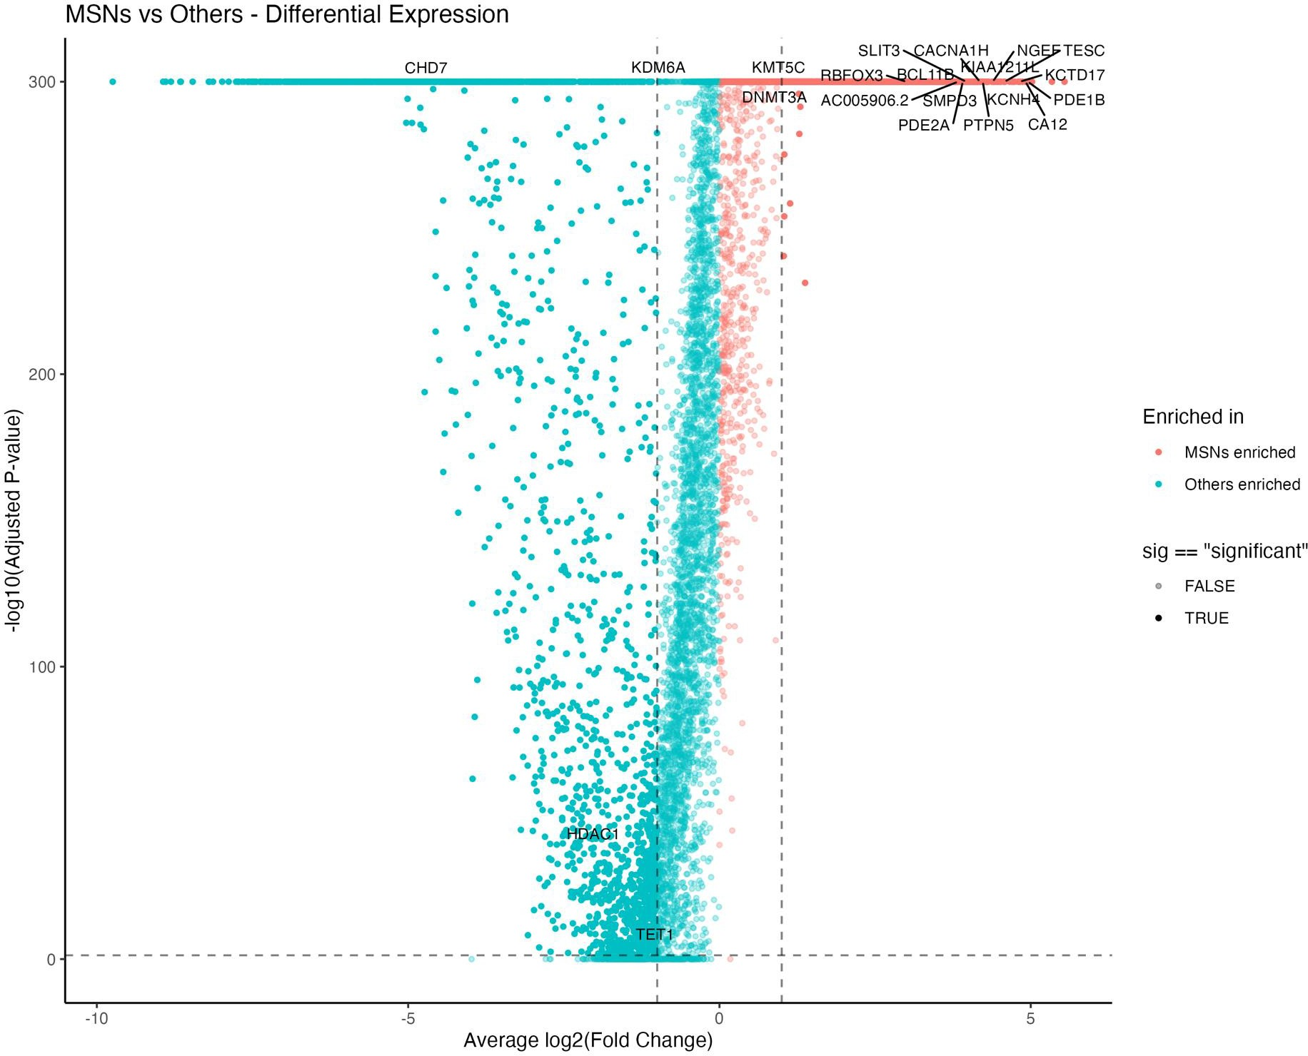

Slide 11
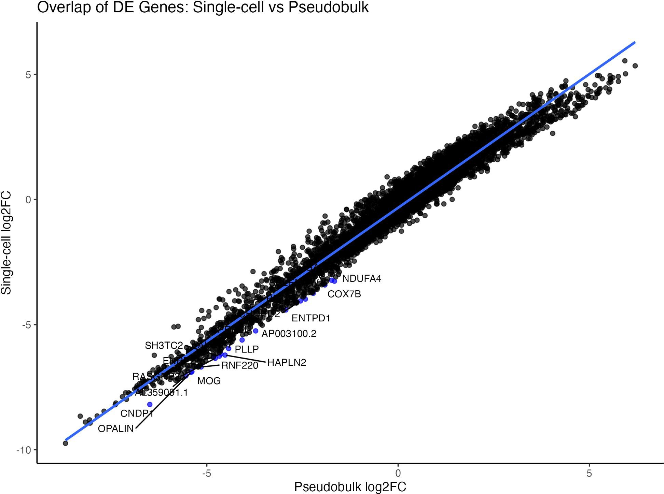

Slide 12
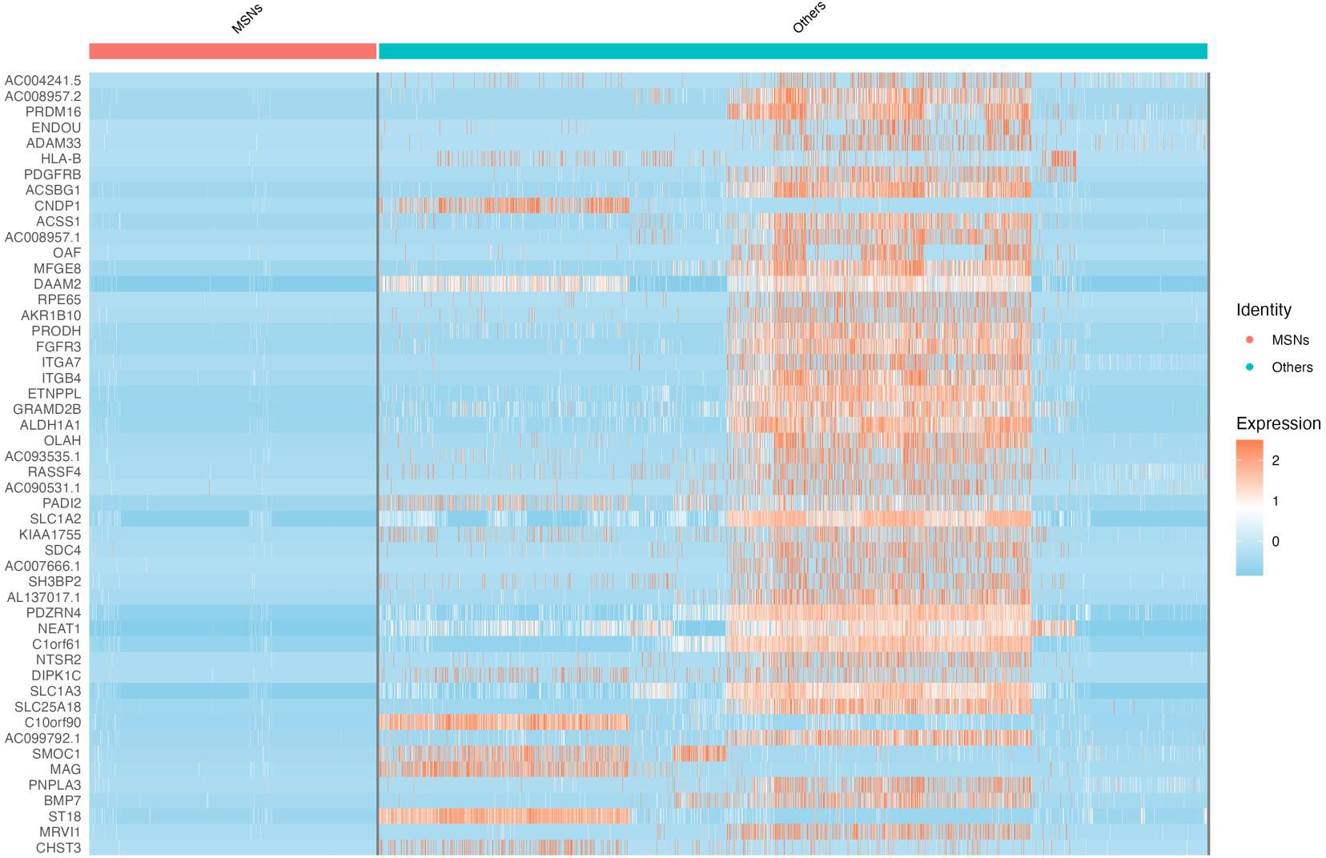

Slide 13
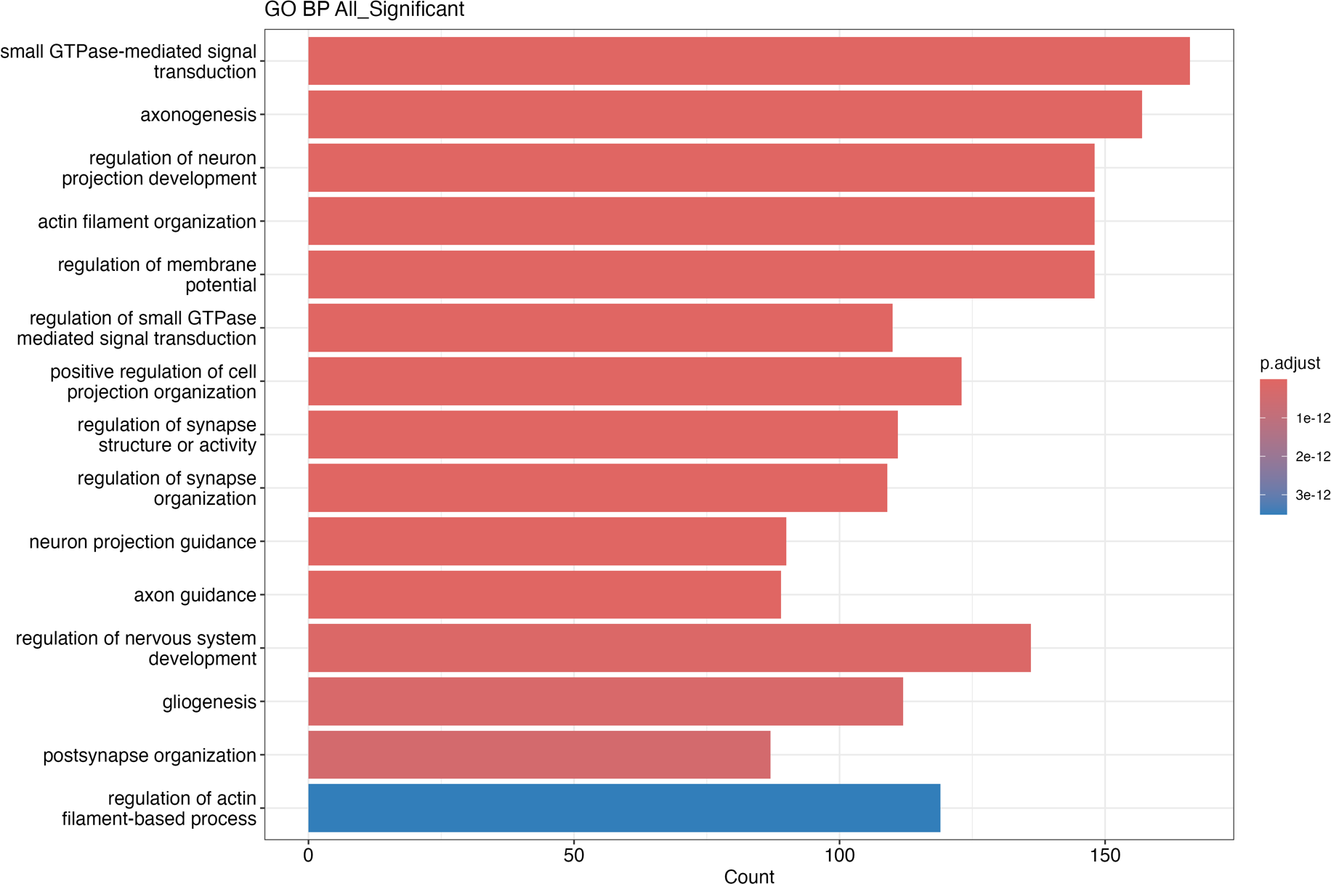

Slide 14
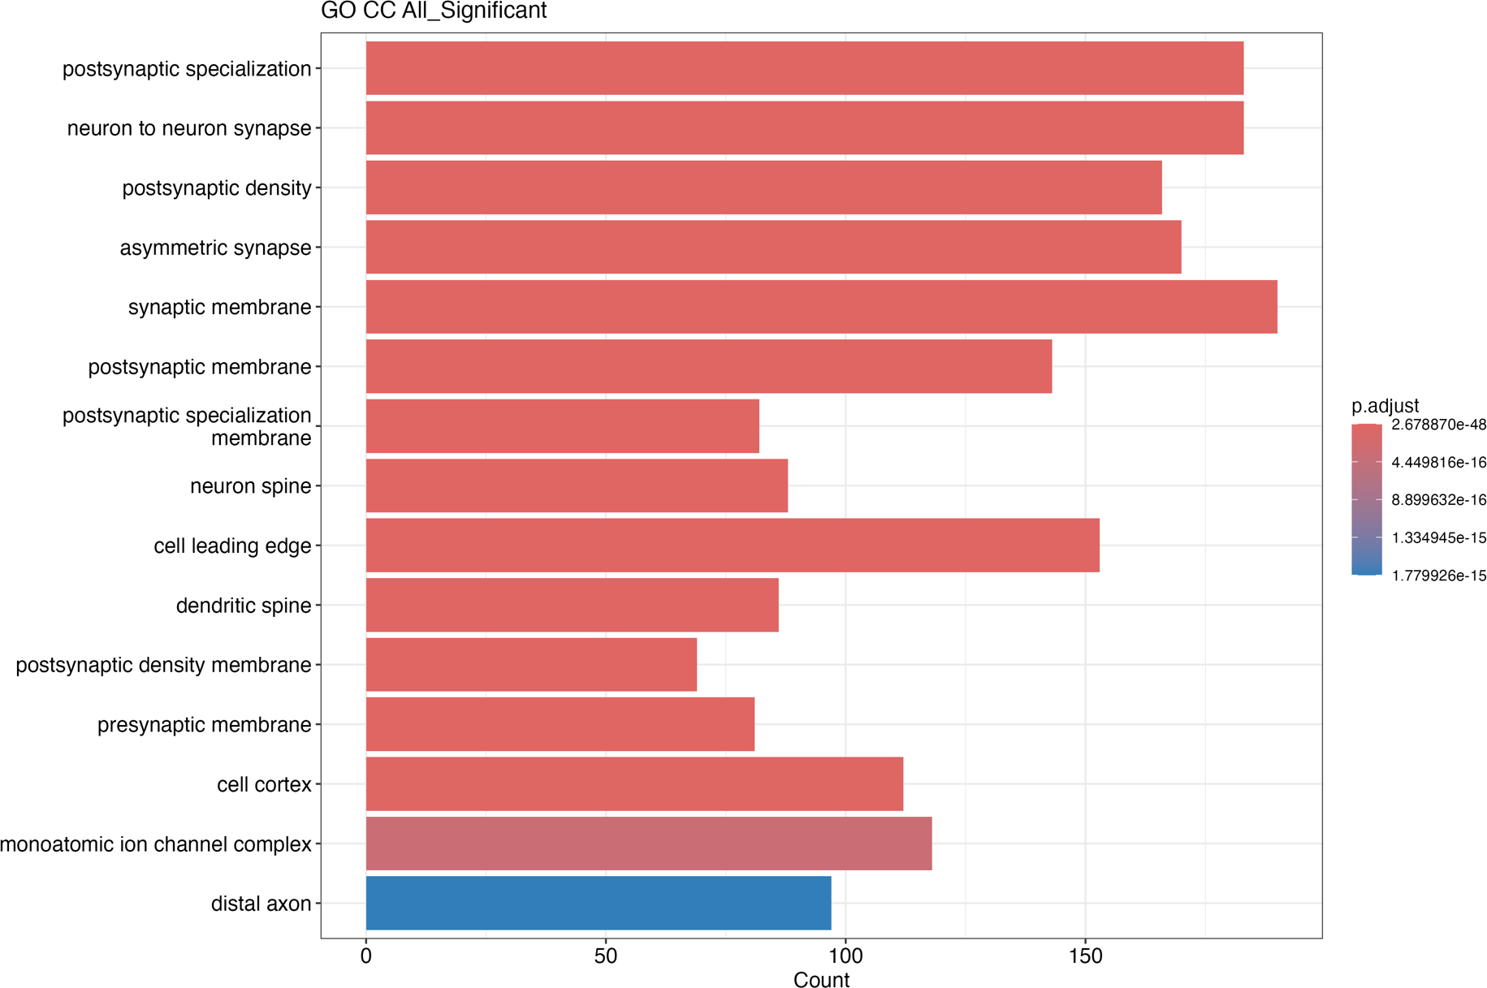

Slide 15
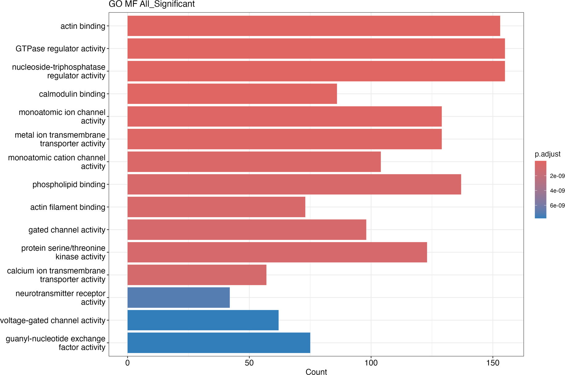

Slide 16
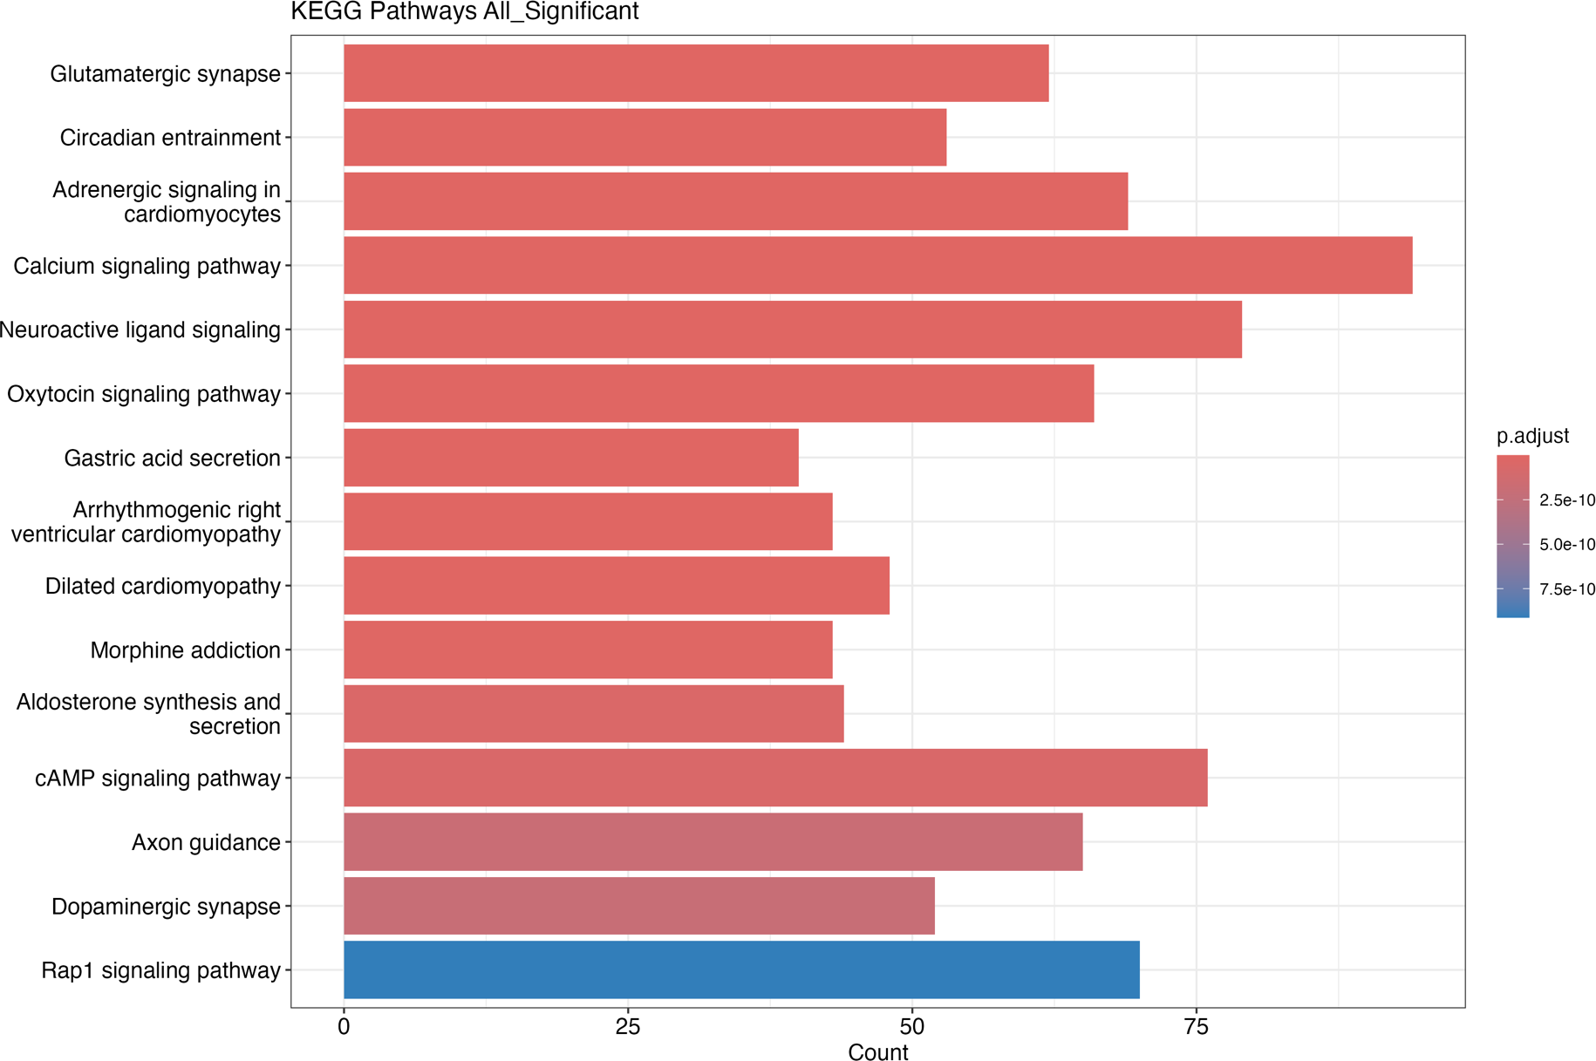

Slide 17
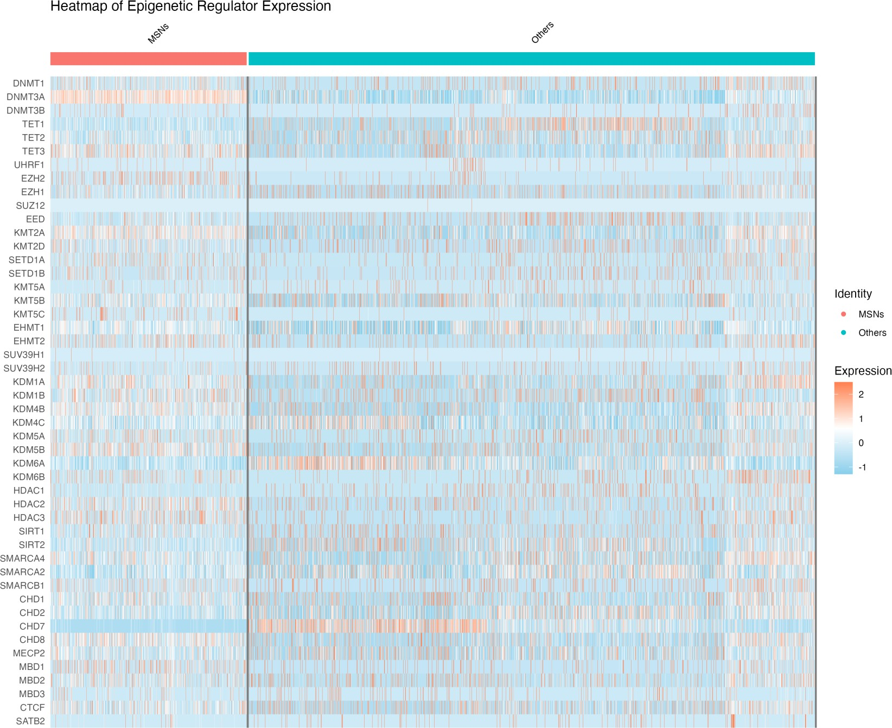

Slide 18
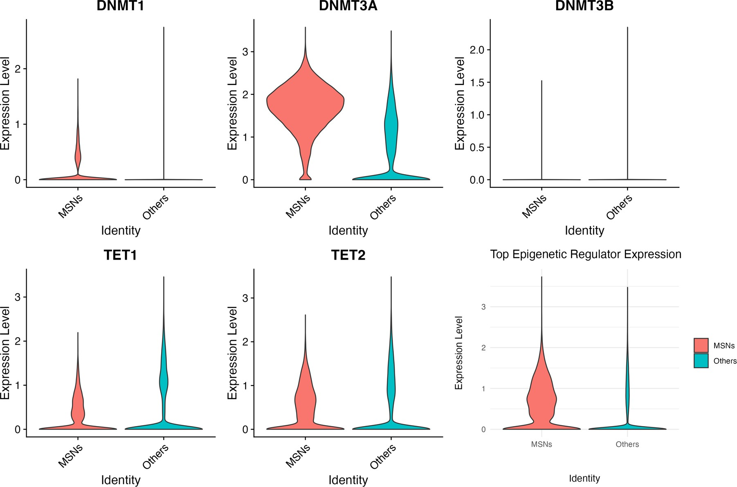

Slide 19
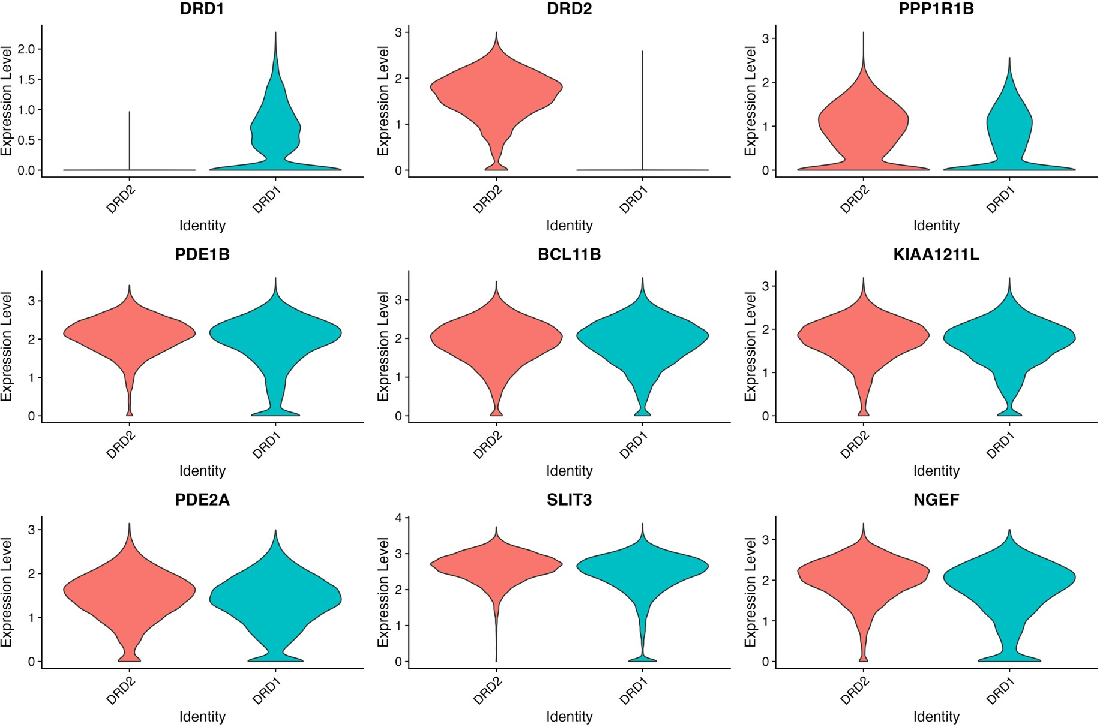

Slide 20
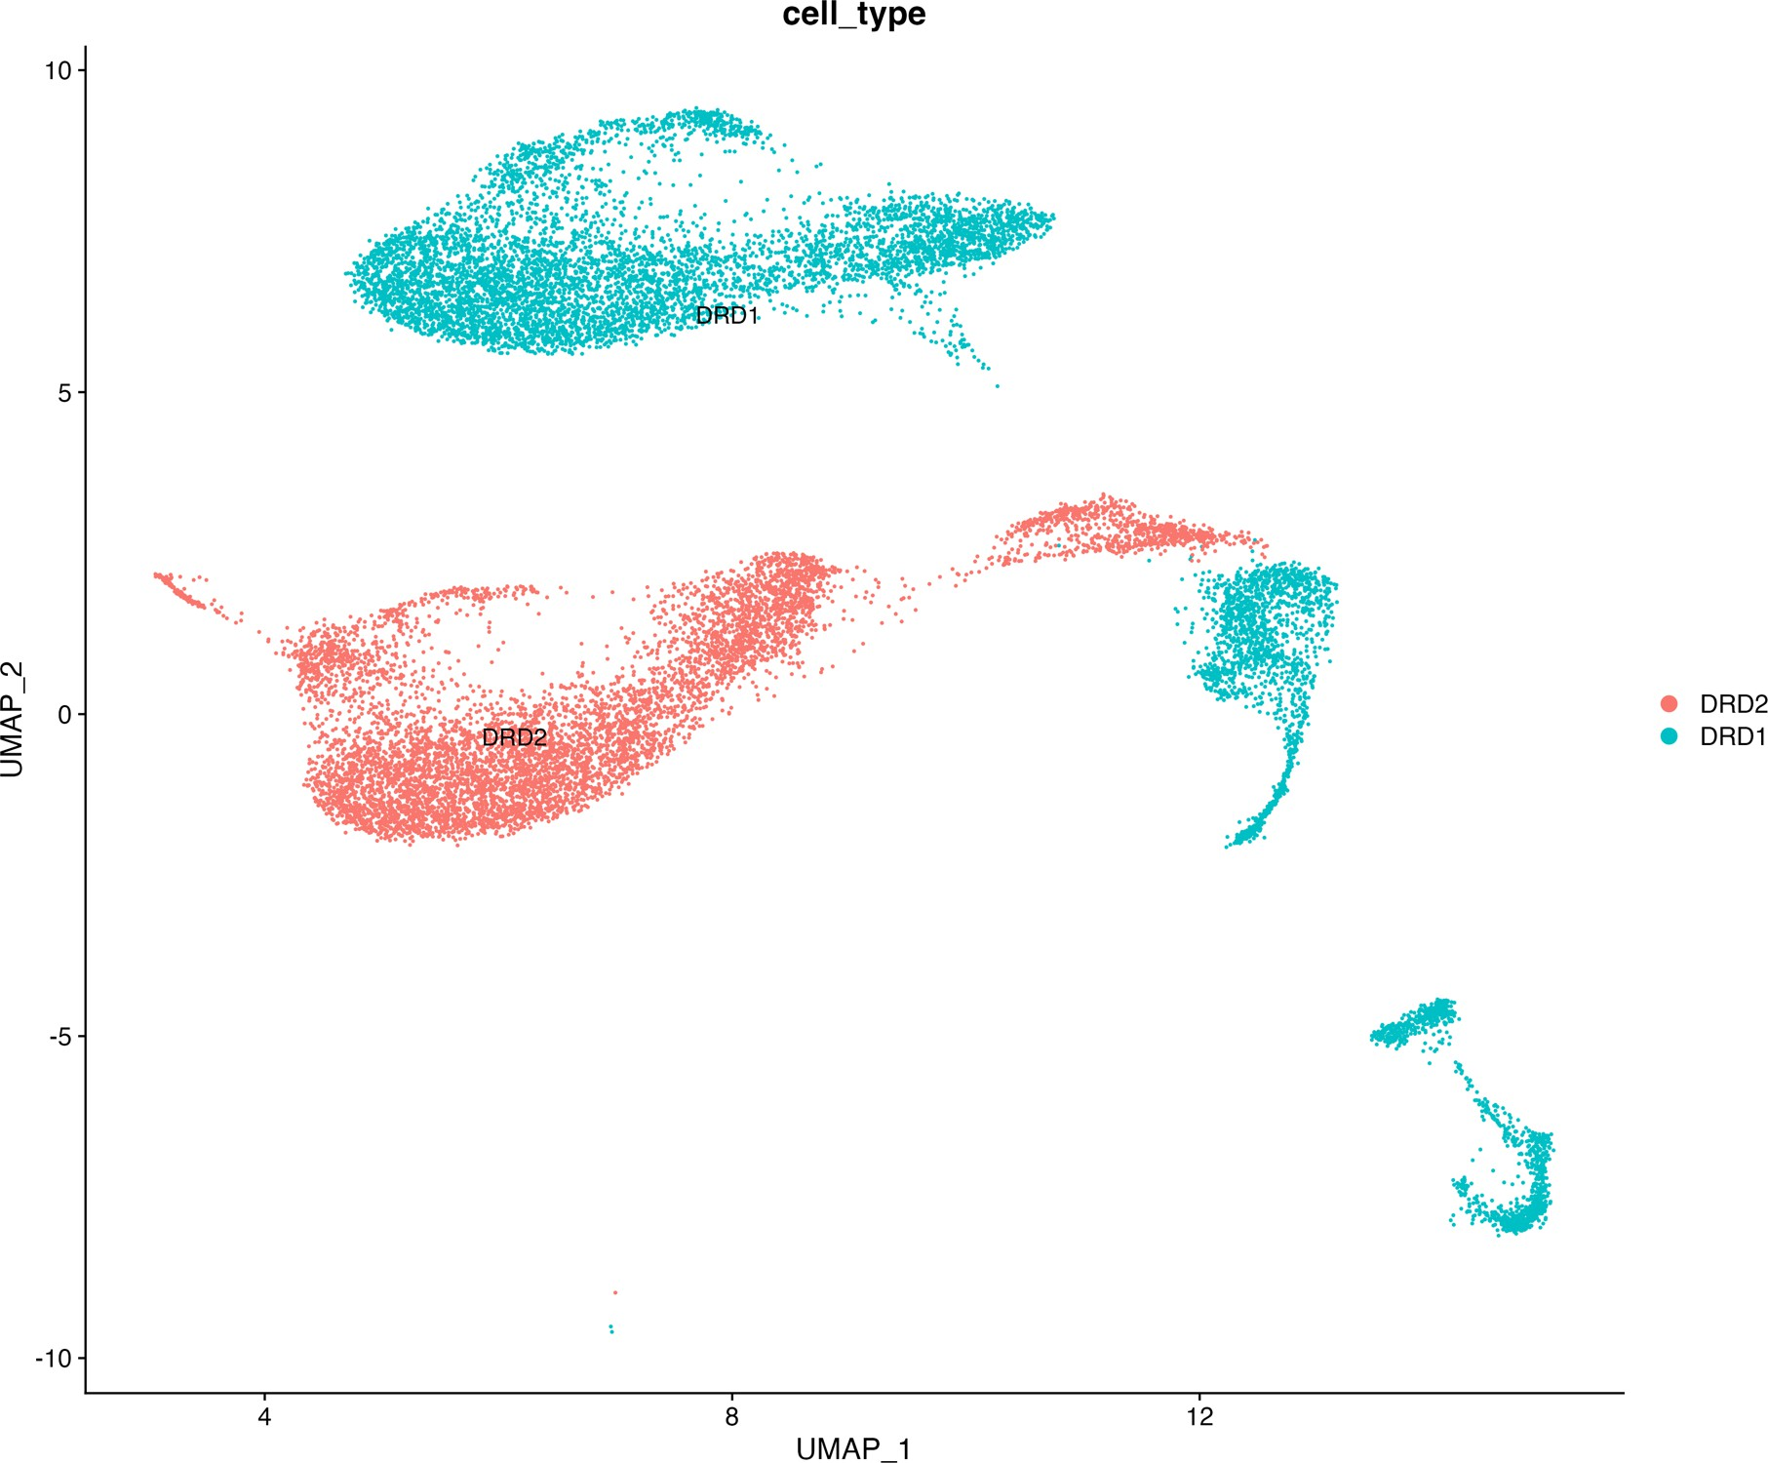

Slide 21
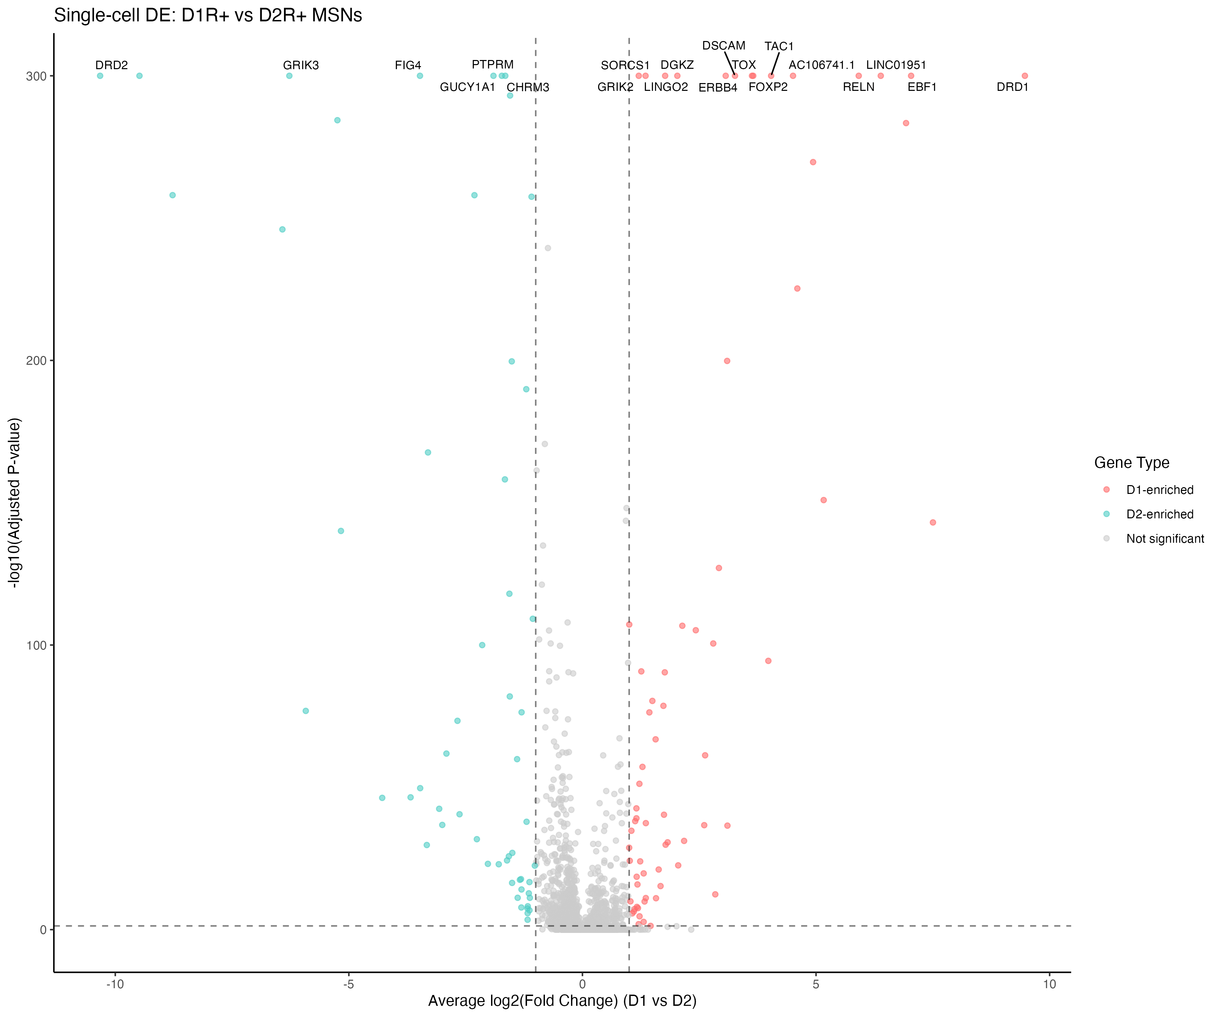

Slide 22
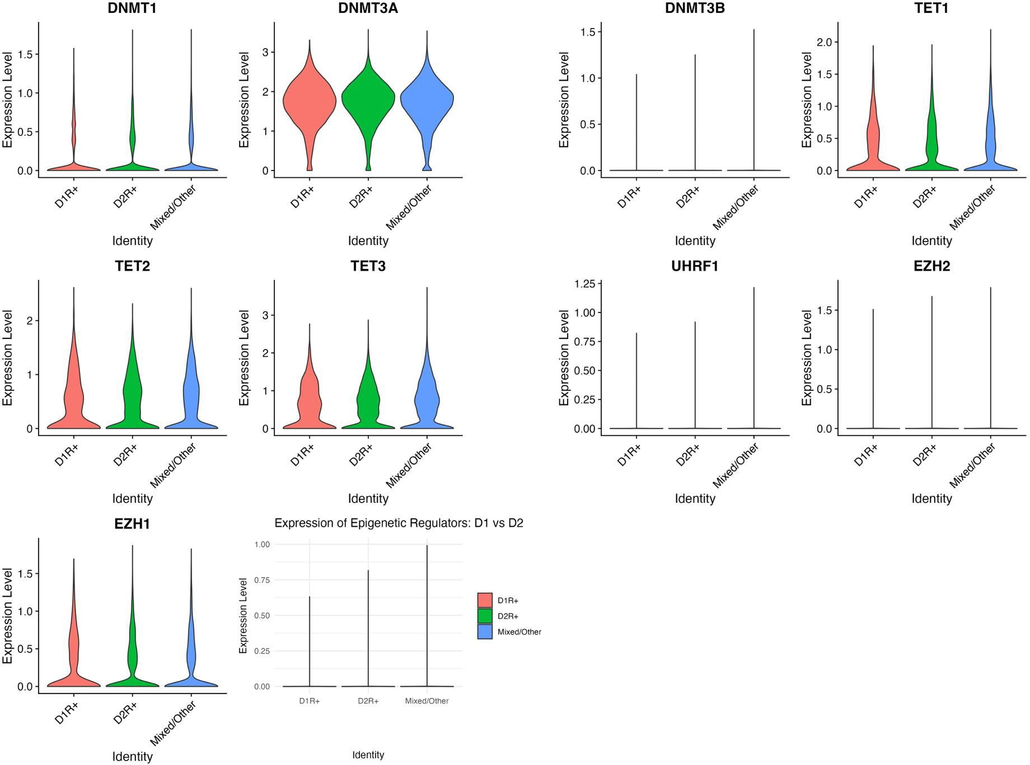

Slide 23
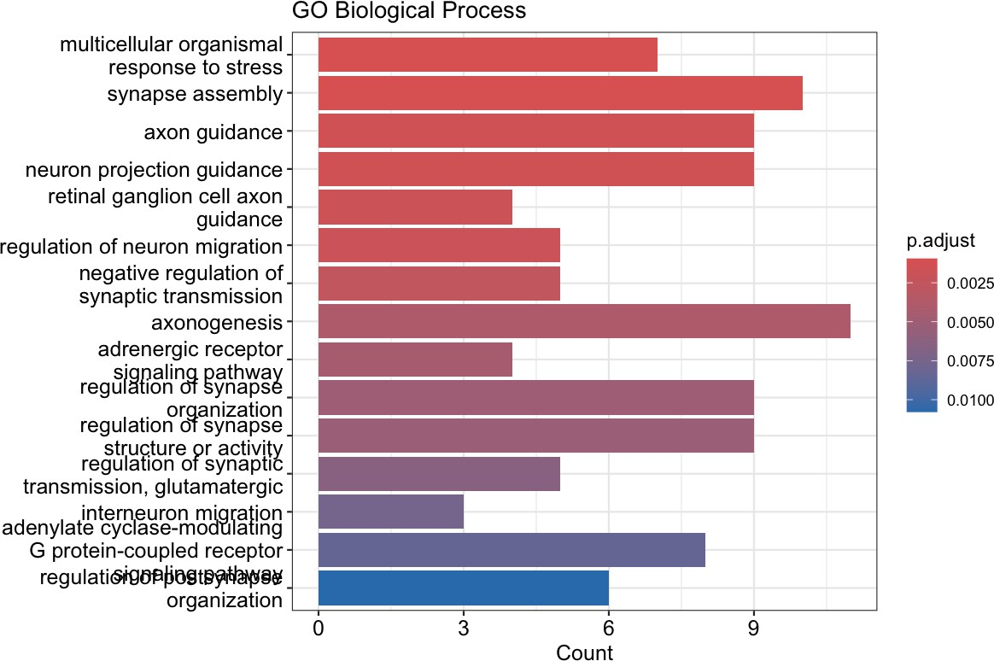

Slide 24
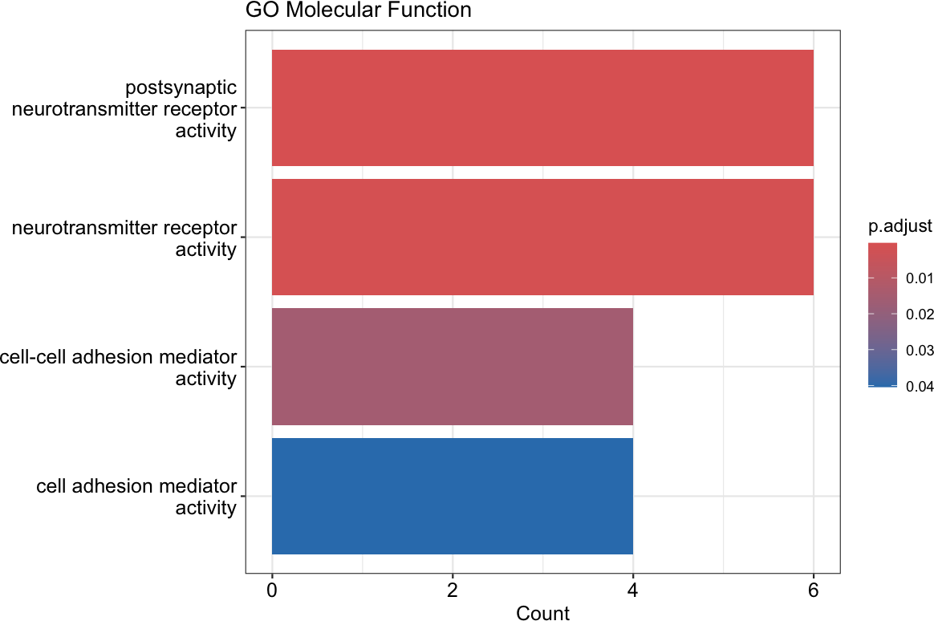

Slide 25
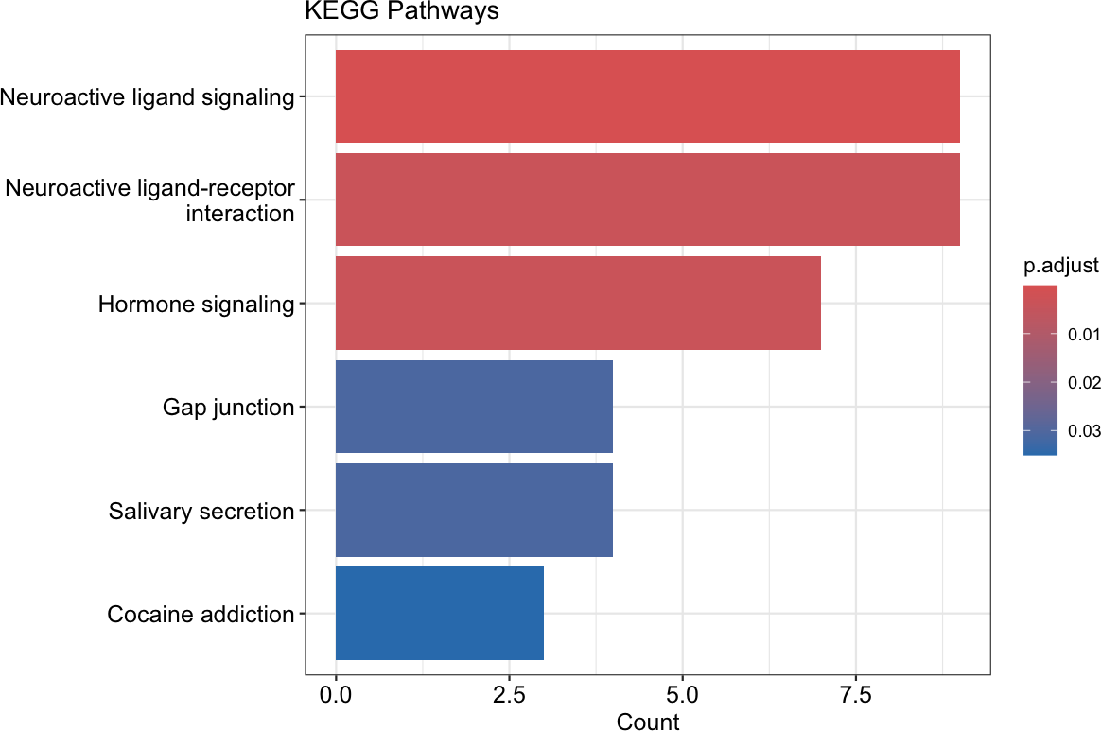

Slide 26
Thank you!

